Slide 1

CRIME RATE Predictor
Aishvwarya Iyer
(16227781)
&
Gayathree Iyer
(16227784)

Slide 2
What is the need of predicting crime rate in USA ?? Motivation
According to The New York Times :
America has definitely more violence when compared to other rich countries.
Murder rates are also much higher in the United States than in countries like Japan, Europe, or Canada.
We also have more assaults, and robberies than other rich countries.
When compared to other affluent nations, crime rates have always been much higher in America. Hence predicting and analyzing crime data is extremely crucial.
Crime has also been the hot topic for the ‘Smart City’ conference.

Slide 3
Our Goal
Crime Rate Predictor is a Cloud Computing project that focusses on applying machine learning algorithm to build models that will not only predict crime rates in various states but also predict the police funding and educational attainment required in the future to mitigate crime.

Slide 4
TEAM MEMBER’S CONTRIBUTION AREA
Google Cloud Platform Infrastructure setup
Python Training Program
Google Big Query
Aishvwarya::
Python Prediction Program
PowerShell Automation Scripts
Google Data Studio
Gayathree::

Slide 5
Technology
Programming Language: Python.
Google Cloud infrastructure is built using terraform scripts.
Automation is done using PowerShell scripts.
Source control management: Github
Github link: https://github.com/CloudComputing-Fall2107/CrimeRatePredictor

Slide 6
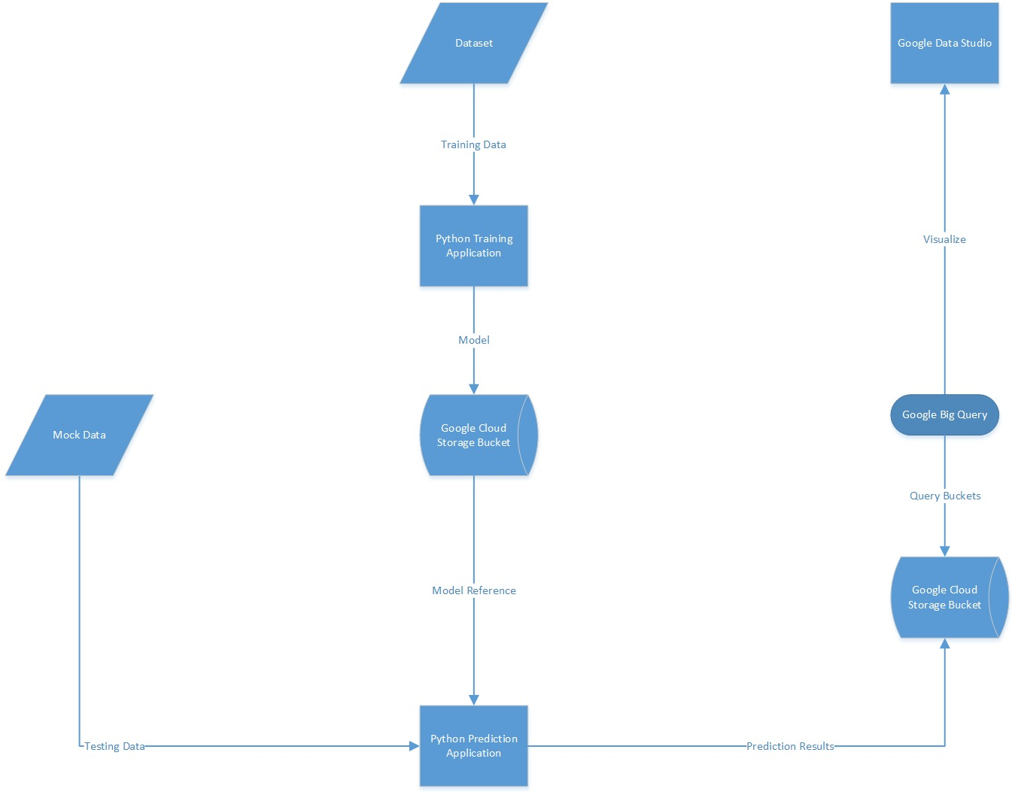
System Architecture

Slide 7
Data set description
The data set contains a case study of education, crime, and police funding for small cities in ten southeastern and eastern states.
The states are New York, South Carolina, Florida, Connecticut, Georgia, Rhode Island, New Hampshire, Maine, North Carolina and Virginia.
The data collected are for a sample of 50 small cities in these states.
X1 = Total Overall Reported Crime Rate per 1 Million Residents
X2 = Reported Violent Crime Rate per 100,000 Residents
X3 = Annual Police Funding (Dollars) per Resident
X4 = Percent of People 25 Years and Older That Have Had 4 years of High School
X5 = Percent of 16- to 19-Year-Olds Not in High School and Not High School Graduates
X6 = Percent of 18- to 24-Year-Olds Enrolled in College
X7 = Percent of People 25 Years and Older with at Least 4 Years of College
X8 = States

Slide 8
Predicting total overall reported crime
Here, we predict the total overall reported crime rate per 1 million residents using:
X2 = Reported Violent Crime Rate per 100,000 Residents
X3 = Annual Police Funding in Dollars per Resident
X4 = Percent of People 25 Years and Older That Have Had 4 years of high school
X5 = Percent of 16- to 19-Year-Olds Not in High School and not high school graduates
X6 = Percent of 18- to 24-Year-Olds Enrolled in college
X7 = Percent of People 25 Years and older with at Least 4 Years of college
X8 = States

Slide 9
Predicting annual police funding in dollars
Here, we predict the annual police funding in dollars per resident using:
X1 = Total Overall Reported Crime Rate per 1 Million Residents
X2 = Reported Violent Crime Rate per 100,000 Residents
X8 = States
Government can decide the annual police funding using this model efficiently to mitigate the crime rate.
According to FBI statistics, annual police funding affects the crime rate to a great extent. Hence, it is very crucial to help the government know the annual police funding in advance.

Slide 10
Predicting age group and educational attainments
Here, we predict the age group and educational attainments of the person committing the crime using:
X1 = Total Overall Reported Crime Rate per 1 Million Residents
X2 = Reported Violent Crime Rate per 100,000 Residents
X3 = Annual Police Funding in Dollars per Resident
X8 = States
According to Alliance report findings, there is an indirect correlation between educational attainment and arrest rates.
According to the most recent data from the U.S. Bureau of Justice, 56 percent of federal inmates, 67 percent of inmates in state prisons, and 69 percent of inmates in local jails did not complete high school.
Plus, when examining total crime savings, the report also forecasts the number of individual crimes that could be avoided by expanding the high school graduation rate by 5 percent, and finds that such an increase would decrease overall annual incidences of larceny by more than 37k; assault by nearly 60k; burglaries by more than 17k and motor vehicle theft by more than 31k. It would also avert nearly 1,300 murders and more than 1,500 robberies.
https://youtu.be/xoYjWkFxpxg

Slide 11
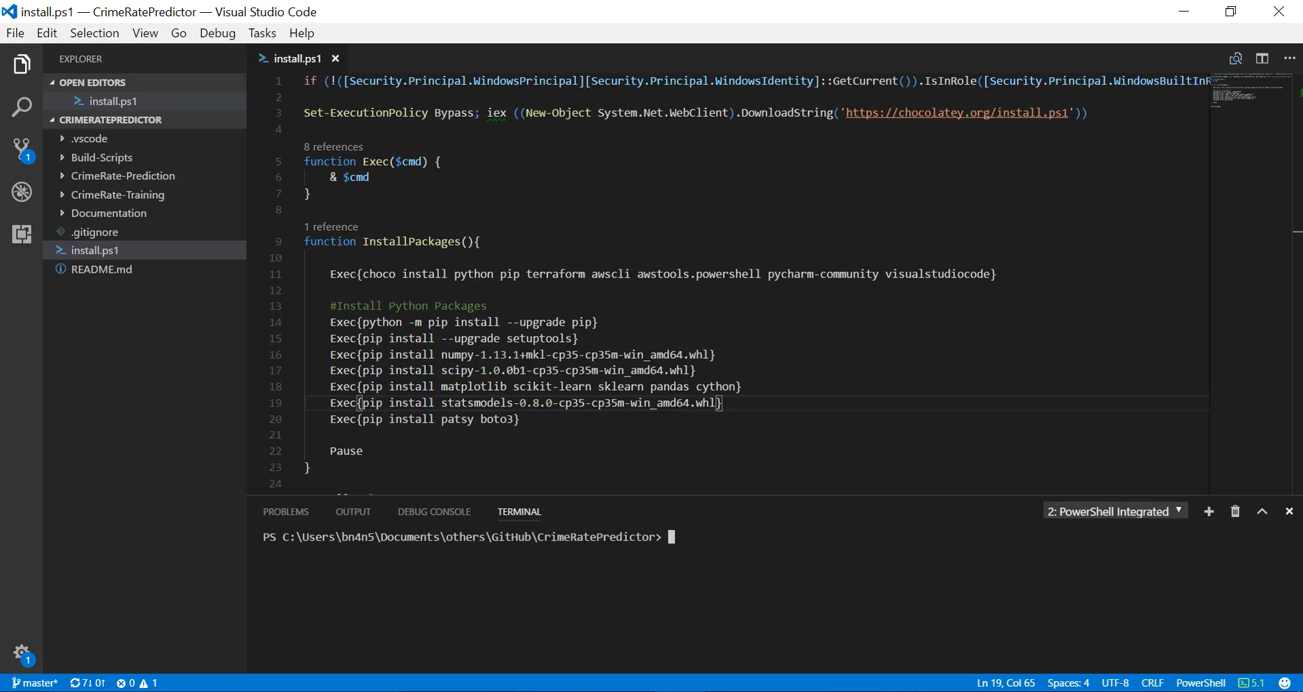

Slide 12
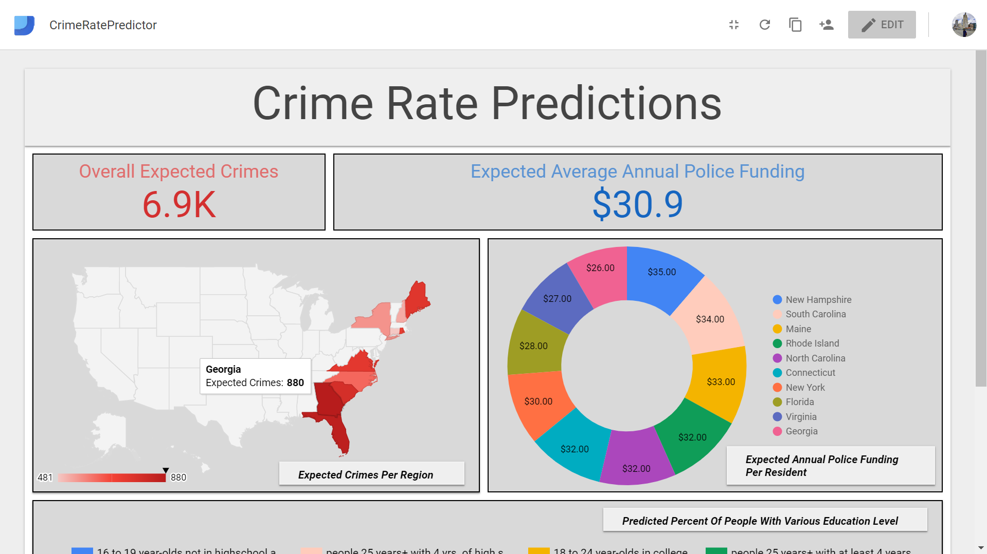
RESults

Slide 13
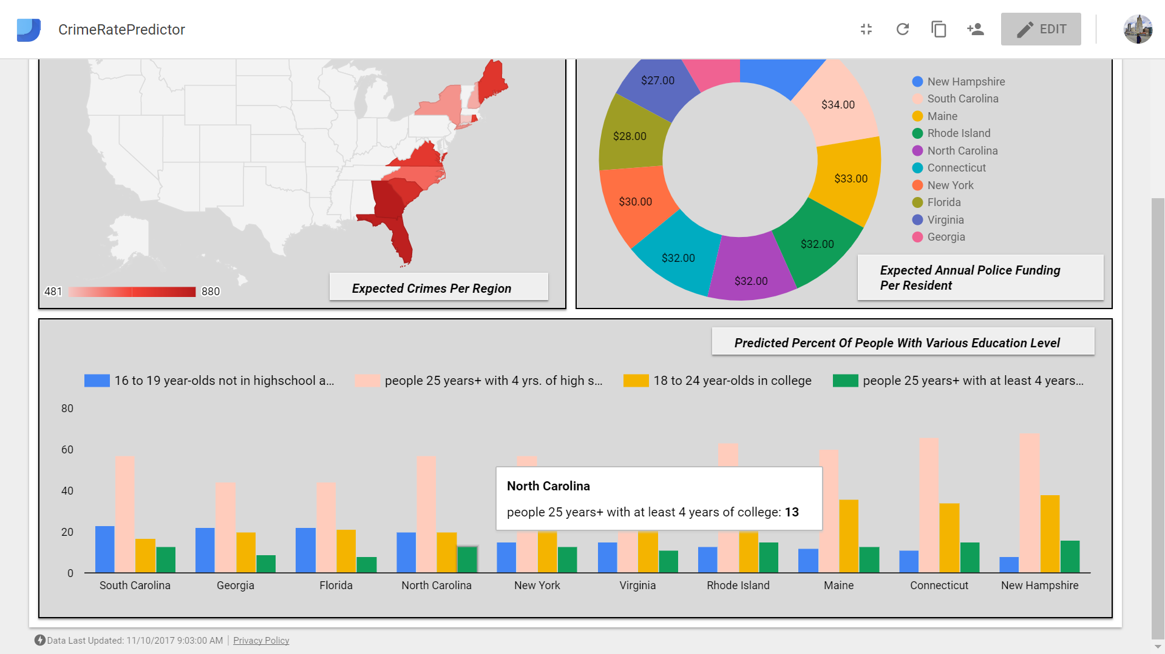
RESults

Slide 14
Problems Faced & Solutions
Our first encounter with Google Cloud Platform.
We looked into various internet sources to understand and start working with Google Cloud Platform.
Retrieving Crime data for all the required regions.
We wanted to consider educational background, police funding and age group as factors of crime in any location. Retrieving such a data set was difficult for most of the cities. We finally, retrieved crime data set for 50 cities in the states mentioned above.
https://youtu.be/xoYjWkFxpxg

Slide 15
Future scope
To consider more factors like economic background, personal conflicts etc.
To predict the crime rate in more cities.

Slide 16
References
http://college.cengage.com/mathematics/brase/understandable_statistics/7e/students/datasets/mlr/frames/frame.html
https://all4ed.org/press/crime-rates-linked-to-educational-attainment-new-alliance-report-finds/
https://www.hackerearth.com/practice/machine-learning/linear-regression/multivariate-linear-regression-1/tutorial/
http://ptl.sys.virginia.edu/ptl/sites/default/files/Area-Specific%20Crime%20Prediction%20Models.pdf
https://www.brookings.edu/research/more-cops/

Slide 17
Thank you !!!

